Slide 1

File Shares
How are sensitive files and documents stored?
Protecting and exploiting file shares

Slide 2



Mentors’ Office Hours
Dhruv 4:00 - 5:00 PM on Monday’s
Drew 12:30 - 1:30 PM on Thursday’s
Sterling 2:00 - 3:00 PM on Friday’s

Slide 3
No Meeting Next Monday
Day off next week due to Martin Luther King Jr. Day
Regular meeting next Tuesday (1/20)

Slide 4
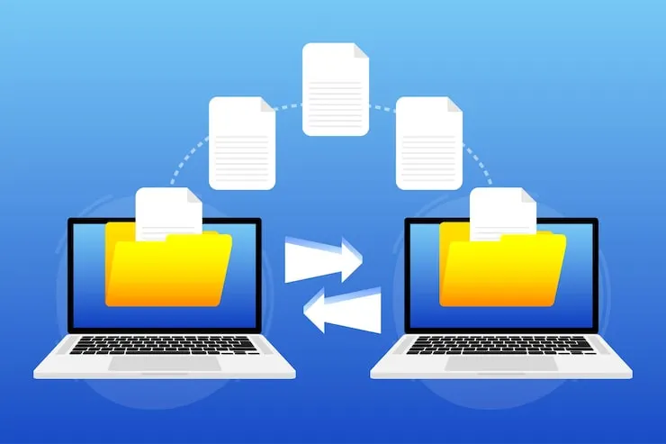
What are file shares and why do we care?
Store internal files and documentation on a dedicated server
Many parties can access the same files
Key component of businesses to securely store and share information
High value target for attackers

Slide 5
Common File Shares
1
2
3
4
Network File system (NFS)
Cloud Solutions
Server Message Block (SMB)
File Transfer Protocol (FTP)
Windows native
Linux/macOS via Samba
Common in Active directory
Cross-platform support
Used for simple file uploads/downloads
Linux/Unix native
Common in server and enterprise environments
Microsoft OneDrive
Google Drive
Dropbox
Apple iCloud

Slide 6
SMB and FTP
SMB
FTP
Windows Native
Commonly on Linux
Default port: 445
Password based authentication
Used in networks utilizing Active Directory
Security Concerns:
Outdated versions (SMB V1)
Poor share permissions
Default port: 21
Password based authentication
Used for simple file servers and public file distribution
Security Concerns:
Lacks Encryption (MiTM Attack)
  Use FTPS
Poor share permissions

Slide 7
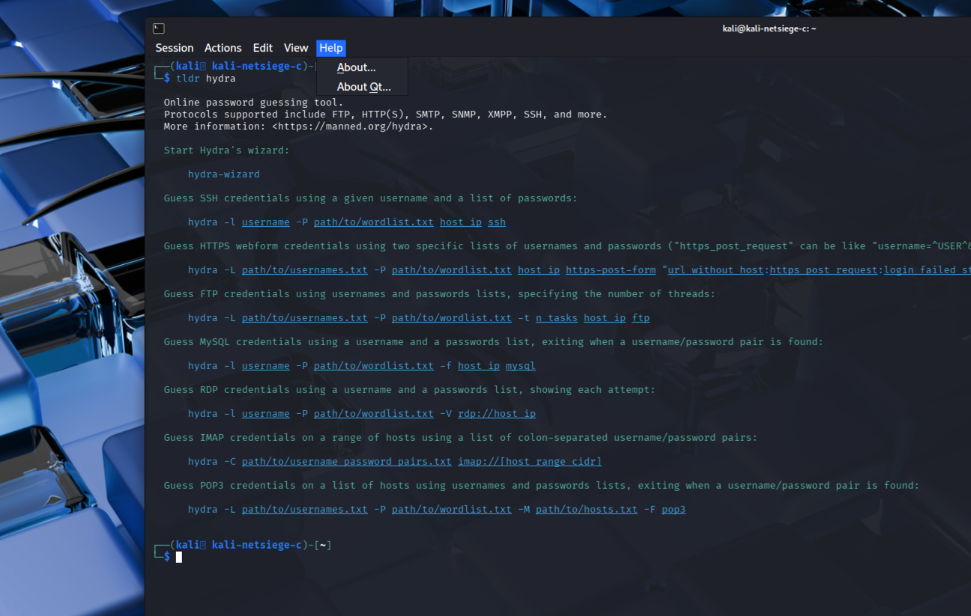
Tip(s)/Trick(s)
tldr
You all have likely heard of the “man” command or the “-h” option to figure out how to use commands.
$ apt install tealdeer
$ tldr <command>

Slide 8
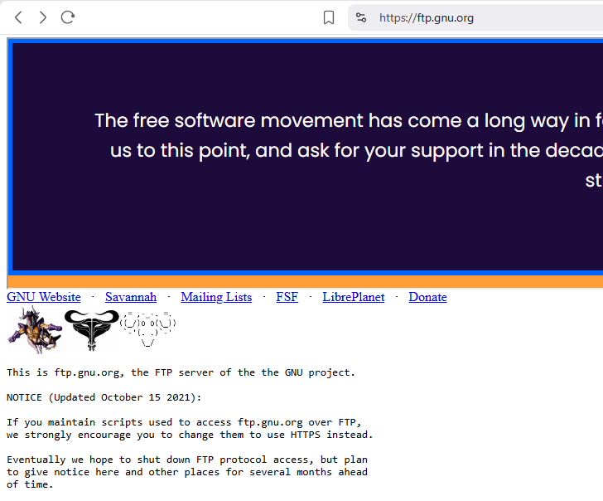
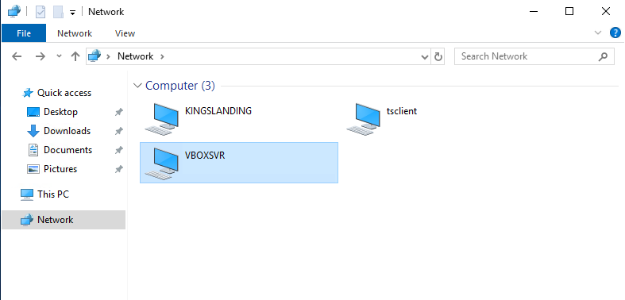
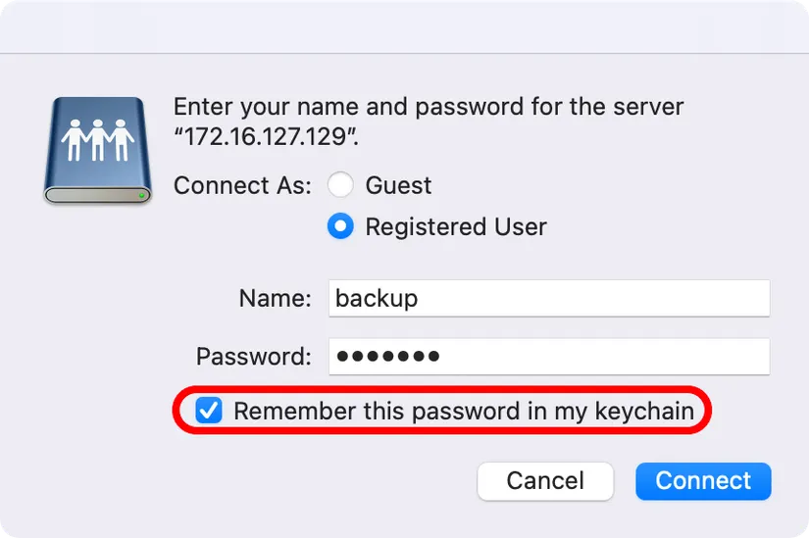
Examples

Slide 9
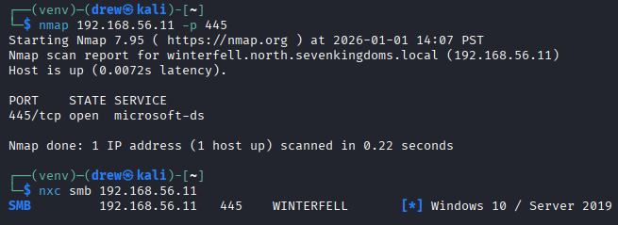
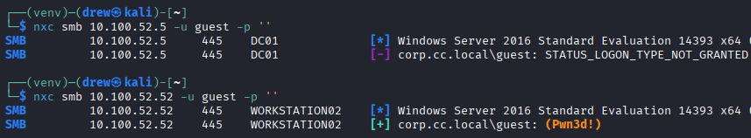
Accessing SMB
Reconnaissance:
NMAP: nmap [ip] -p 445
  Alternatively: nxc smb [ip]
Guest Access:
  nxc smb [ip] -u guest -p ‘ ‘
User Access:
  nxc smb 192.168.56.11 -u [user] -p [password]

Slide 10
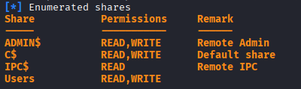
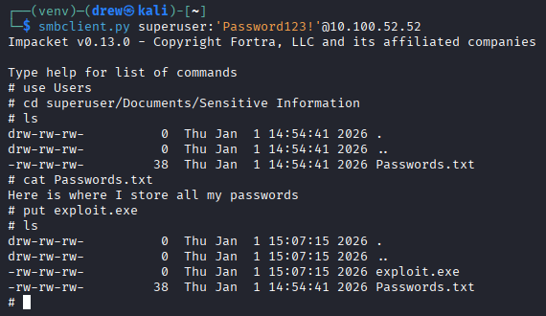
Accessing SMB Continued
List Shares:
nxc smb [ip] -u [user] -p [password] -- shares
Read Shares:
  smbclient //server/share --user [username]
  Linux commands!
Upload:
  put [file]
Default Shares

Slide 11


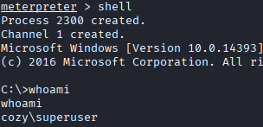
SMB Code Execution
Code Execution is possible
Run commands:
nxc smb [ip] -u [user] -p [password] -X [cmd]
Options:
  Get permissions
  Read files on the server hosting SMB
  Get a reverse shell
  Dump secrets

Slide 12
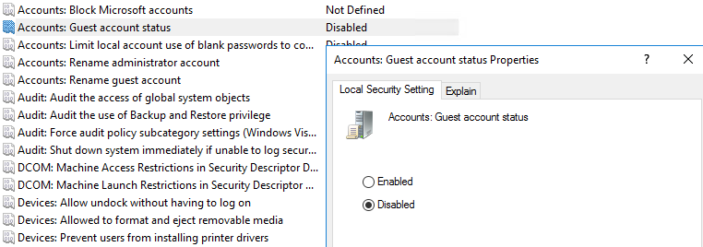
Hardening SMB
Remove Anonymous Auth:
Set-SmbServerConfiguration -EnableAuthenticateUserSharing $true -Force
Disable SMBv1:
Set-SmbServerConfiguration -EnableSMB1Protocol $false -Force
GUI Hardening:
  Win+R > gpedit.msc
  Windows Settings > Security Settings > Local Policies > Security Options

Slide 13
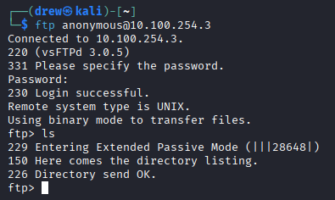
Accessing FTP
NMAP: nmap [ip] -p 21
Connect: ftp anonymous@[ip]
  Enter any password
Linux commands to navigate
get/put to get or place files
Run ls -la as some files could be hidden

Slide 14
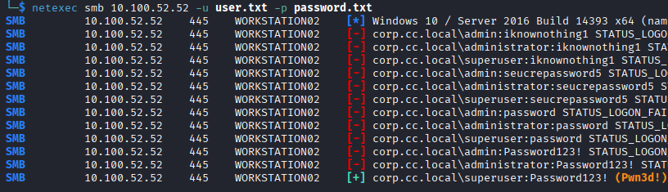
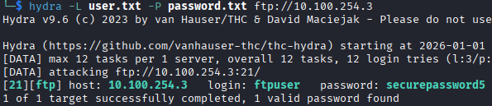
Password Brute-Forcing
SMB
FTP
Via NetExec
Via Hydra
netexec smb [ip] -u user.txt -p password.txt
Be careful to not lock any user out!
hydra -L user.txt -P password.txt ftp://[ip]
Lowercase L/P for single user/password
Once again do not lock users out!
Wordlist: /usr/share/wordlist/rockyou.txt

Slide 15
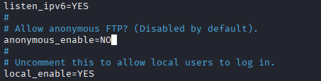
Hardening FTP
Remove Anonymous Auth:
  Config file located in: /etc/[FTP Provider].conf
    E.g (/etc/vsftpd.conf)
  anonymous_enable=NO
Strong passwords, proper user permissions
Brute force lockout policy
  Fail2Ban
Do not use any unencrypted FTP
  FTPS

Slide 16
Key Ideas
1
SMB vs FTP
2
NetExec and smbclient
3
Hydra and ftp
4
How can we hardening SMB?
5
How can we harden FTP?

Slide 17
Extra Credit
1
Dumping secrets via SMB
2
Reverse shells with FTP
3
Command Execution with SMB
4
SMBv1
5
Questions and Support

